Slide 1


SMART INDIA HACKATHON 2025
Real-time Public Transport Tracking For Small Cities
Transportation & Logistics | Software Solution
Revolutionising public transport efficiency through intelligent tracking
systems for emerging urban centres across India.
Problem Statement Id- 25013
Team ID: [To be assigned] | Team Name: CodeNova

Slide 2

The Challenge & Our Innovation
CodeNova
Current Problem
Tier-2 cities lack real-time bus info (UMI 2024)
Commuters face delays, overcrowding and low reliability
India loses billions annually due to congestion and inefficiency
Our Solution
Web platform showing real-time bus tracking
Live locations, estimated arrival times, buses stops info
Low Bandwidth optimised
Our innovative approach combines live GPS tracking with intelligent
prediction algorithms, enabling passengers to monitor bus locations
in real-time and plan their journeys effectively.
@SIH Idea submission- Template
2

Slide 3
Technical Implementation Strategy & stack
CodeNova
01
02
03
Frontend Development
Frontend is built with HTML, CSS and JS for a responsive and efficient user experience
Backend Development
Backend uses Django for reliable, scalable and open-source development.
Database Architecture
Database models are set for buses, their stops, their schedules and users
04
05
GPS Integration
GPS data will be fed via devices across buses or open-source APIs. Mapping will use Leaflet or a similar kind of lightweight tool for better performance
Implementation
Build a functional prototype, integrate GPS, followed by offline features for low connectivity.
@SIH Idea submission- Template
3

Slide 4
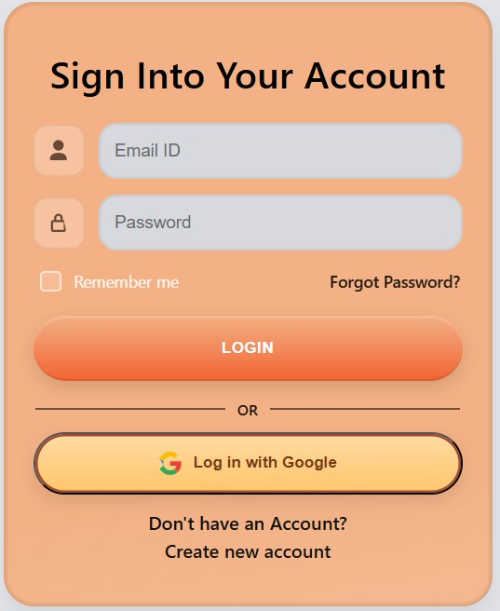
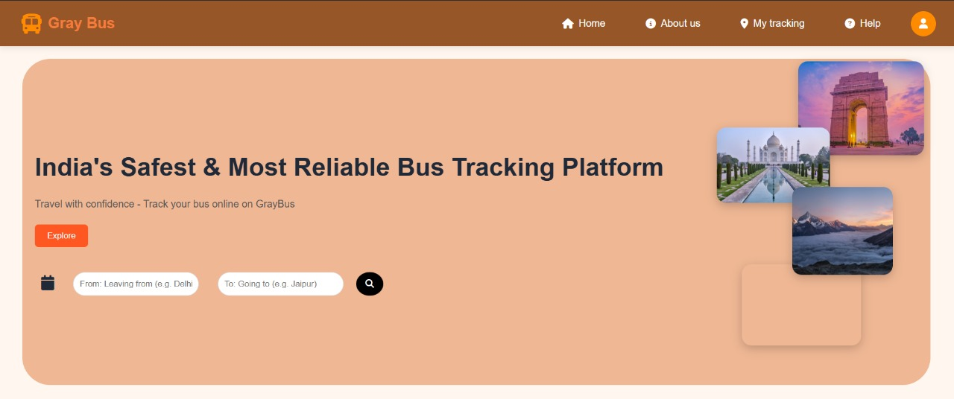
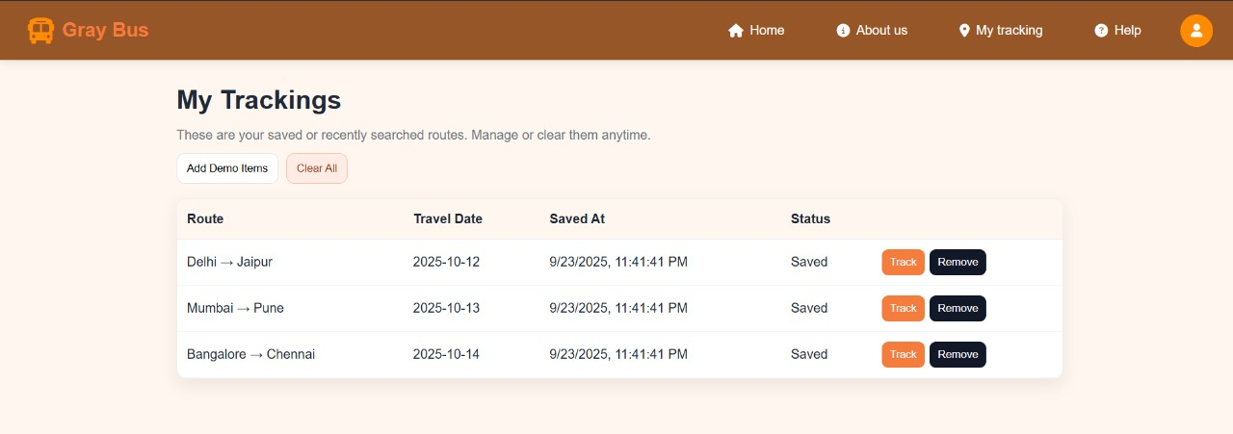
FEASIBILITY AND VIABILITY
CodeNova
Challenges
~GPS/live data availability.
~Real-time tech complexity
~Low user awareness.
Feasibility
~High demand for real-time tracking.
~Few reliable solutions in India.
~Scalable across cities/routes
Strategies
~Use open-source maps
~Start with dummy data → live GPS ~Optimize backend (Django + caching)
~Partner with transport authorities
~Simple, user-friendly UI
~Strong data security
.
Risks
~High API costs
~Data privacy issues
@SIH Idea submission- Template
4

Slide 5



Transformative Impact
CodeNova
Social Benefits
Reduces passenger anxiety, improves accessibility for elderly and disabled citizens, and enables predictable travel planning for daily activities.
Economic Impact
Increases productivity through reduced commute uncertainty. Over time, this decreases the reliance on private vehicles and helps India save billions on fuel wastage, traffic jams and congestion.
Environmental Impact
Promotes sustainable transport choices, reduces private vehicle dependency, and contributes to lower carbon emissions in urban areas.
Over time, this platform transforms local transport into smart mobility, helping tier-2 and tier-3 cities join the digital India revolution with tangible improvements for all.
@SIH Idea submission- Template
5

Slide 6
CodeNova
RESEARCH AND REFERENCES
🔹 Research Reports:-
Urban Mobility India Report 2024: Highlights the daily problems and delays faced by commuters in small cities.
ORF Data: Shows how much money India loses each year due to public transport inefficiency
🔹 Commuter Insights and App Analysis:-
Real commuter feedback and case studies helped design practical features.
Existing apps like "Where is My Train" were studied for strengths and weaknesses.
🔹Technical References:-
Django docs for backend
Font Awesome for icons
Figma for UI/UX designs
Kaggle and Open Street Map for transport and map data
MDN, W3schools, GeeksforGeeks for code guidance
RedBus, Google Maps for public transport benchmarking
@SIH Idea submission- Template
6

